Slide 1


Task Oriented Programming
with
-
A Domain Specific Language embedded in
Rinus Plasmeijer – Bas Lijnse
Peter Achten – Pieter Koopman - Steffen Michels
Jurriën Stutterheim - Markus Klinik - Tim Steenvoorden - Mart Lubbers – Arjan Oortgiesen
Jan Martin Jansen (NLDA) – John van Groningen - Laszlo Domoszlai (ELTE)
Radboud University Nijmegen

Slide 2
Overview
Introduction to Task Oriented Programming / iTasks
iTask Overview
Task Values
Basic Tasks: Editors
Task Combinators
Sequential Combinators
Parallel Combinators
Shared Data Sources
Current Research
Semantics
Conclusions

Slide 3
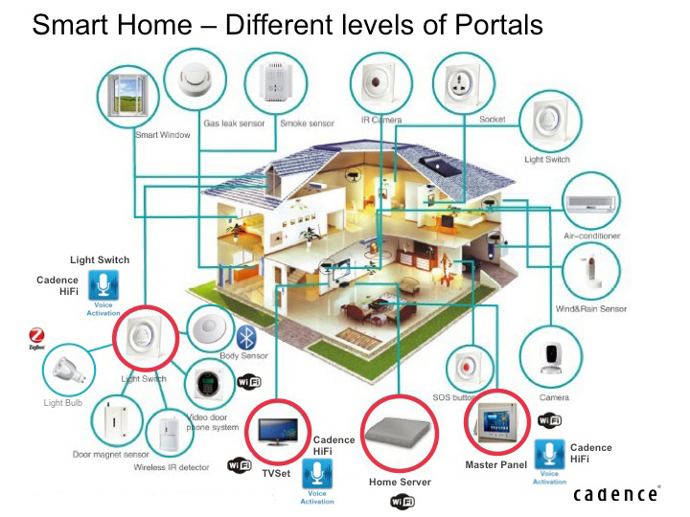
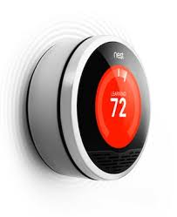
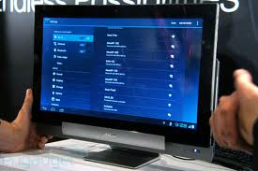


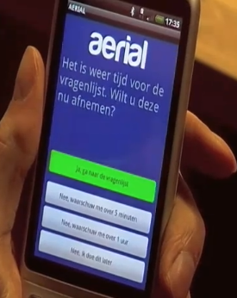

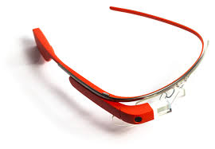

Modern Ways of Working
iTask App
Computer
Laptop
Tablet
Smart Phone
Smart Everything / IoT
Internet
Server
Cloud / Database
Notify everyone
when data
changes
Notes:
Opbouwen op basis van de componenten uit ingredienten sheet.

Slide 4


Modern Ways of Working
Software
for Browser
Apps
on Client
“Cool”
User
Interfaces
iTask App
Computer
Laptop
Tablet
Smart Phone
Smart Everything / IoT
Small Apps
on Client
“Cool”
User Interfaces
Internet
Coordinate
Collaboration
All Devices
Coordinate
All Devices
Coordinate
Collaboration
All Devices
Server
Cloud / Database
Handle
Communication
Synchronize
Clients - Servers
Handle
Data Storage
Data Retrieval
Synchronize
Clients - Servers
Synchronize
Clients - Servers
Notify everyone
when data
changes
Software on Server
Notes:
Opbouwen op basis van de componenten uit ingredienten sheet.

Slide 5

Software Pollution
Functionality –Algorithms & Data Structures
User Interface– Clear, nice, easy to use interaction wit the end user demanded
Storage - Persistent storage of Information
Many Components - Communication & Synchronization of Information needed
Multi Platform – Different OS Systems / Libraries / Programming Languages / …
Efficiency / Maintainability / Scalability / Security / Integration with other systems /…
All these things have to be controlled by software !
Too many things to handle, software gets very messy !
Hard to find out what an application actually is doing …
How to structure the software, achieve separation of concerns ?
Software should focus on the tasks to do (what), not on the technical realization (how)

Slide 6
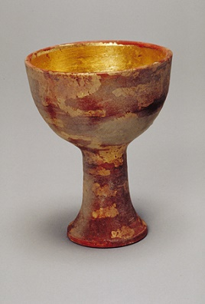
Task Oriented Programming ?
New flavor of Functional Programming, even a new Programming Paradigm… for developing applications coordinating people and systems collaborating on the internet.
Tasks as central concept
Tasks are a common notion in daily life / in any organization
Computers often play a central role when performing a Task
Many programming concepts can be seen as a Tasks to be executed by a computer
Tasks are described on a high level of abstraction
Reactive: a task produce an observable value changing over time
Combinators to define tasks in terms of sub-tasks
Data flow: tasks are automatically updated when observed values are changing
Don’t worry about the technology realization !
Generate as much as possible automatically : agile development, rapid prototyping
Allow fine tuning to make it look nicer and more efficient where needed !

Slide 7


What is the iTasks System ?
Implementation of the Task Oriented Programming paradigm
It is an Embedded Domain Specific Language, embedded in
Uses advanced FPL techniques to generate the required software technically needed
First concept 2007 (ICFP), Operation Semantics TOP 2012 (PPDP)
about 30 papers on TOP / iTasks
Version 4.x of the iTask System

Slide 8
iTasks Architecture
My iTask
Specification
Notes:
Opbouwen op basis van de componenten uit ingredienten sheet.

Slide 9
iTasks Architecture
iTask Web Server
iTask Combinator
Library
My iTask
Specification
Notes:
Opbouwen op basis van de componenten uit ingredienten sheet.

Slide 10
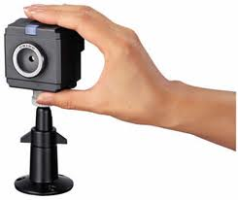
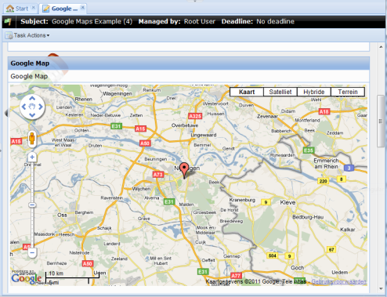
iTasks Architecture
iTask App
Computer
Laptop
Phone
Tablet
Sensor
iTask Client
iTask Client
iTask Client
iTask Client
iTask Client
iTask User
iTask User
iTask User
iTask User
iTask User
WEB
Web Service
Web Service
Web Service
RPC
Cloud / Database
iTask Web Server
iTask Web Server
iTask Combinator
Library
iTask Combinator
Library
My iTask
Specification
iTask
Specification
Notes:
Opbouwen op basis van de componenten uit ingredienten sheet.

Slide 11
Technical issues the iTask system will do for you …
Generates Web-Service for Server which coordinates the tasks, as described
One language approach (Clean), generates code for Server(s) and for Clients
Multi-platform: Windows & MacOS (Intel), Android & Raspberry Pi (ARM), Browser (Java script)
Any Closure (function to be evaluated) can be send from one platform to another
We can distribute Servers over Clients
Generates GUI’s on clients, handles interaction, updates clients
Offers an up-to-date dedicated Model-View to end-users of information shared between tasks
Distributed spreadsheet-like behavior (publish-subscribe system)
Persistent: remembers the work taken place & done so far
Any system may be switched of any time
Generate as much as possible automatically, but one can fine-tune when needed

Slide 12
Papers on iTasks
First paper on iTasks:
iTasks: Executable Specifications of Interactive Work Flow Systems for the Web (ICFP 2007)
General:
An Introduction to Task Oriented Programming (CEFP 2013)
Static and Dynamic Visualisations of Monadic Programs (CEFP 2015)
GUI:
iTask as a new paradigm for building GUI applications (IFL 2010)
Task Oriented Programming with Purely Compositional Interactive Scalable Vector Graphics (IFL 2014)
Towards Customizable Generic Task User-Interfaces in iTasks (IFL 2016)
Towards the Layout of Things (IFL 2016)
Tooling:
GiN: a graphical language and tool for defining iTask workflows (TFP 2011)
Tonic: An Infrastructure to Graphically Represent the Definition and Behaviour of Tasks (TFP 2013)
Semantics:
Task Oriented Programming in a Pure Functional Language (PPDP 2012)
iTasks for a change - Type-safe run-time change in dynamically evolving workflows (PEPM 2011)
Evolution of a Parallel Task Combinator (Springer 2013)
Getting a grip on tasks that coordinate tasks (LDTA 2011)
Parametric Lenses: change notification for bidirectional lenses (IFL 2014)
Using DSLs to help people solve rule-based problems (TFP 2016)
An Executable and Testable Semantics for iTasks (IFL 2008)
Predicting Resource Consumption of Higher-Order Workflows (PEPM 2016)
Client site evaluation of Tasks:
Transparant Ajax and Client-Site Evaluation of iTasks (IFL 2007)
iEditors: Extending iTask with Interactive Plug-ins (IFL 2008)
Editlets: type based client side editors for iTasks (IFL 2014)
A Portable VM-based implementation Platform for non-strict Functional Programming Languages (IFL 2016)
Task Oriented Programming on a Distributed Server Architecture (draft)
Applicability:
A Conference Management System based on the iData Toolkit (IFL 2007)
Web Based Dynamic Workflow Systems for C2 of Military Operations (ICCRTS 2010)
Managing COPD exacerberations with telemedicine (AIME 2010)
Towards Dynamic Workflows for Crisis Management (ISCRAM 2010)
Capturing the Netherlands Coast Guard's SAR Workflow with iTasks (ISCRAM 2011)
A Task-Oriented Incident Coordination Tool (ISCRAM 2012)
Using Process-Oriented Interfaces for Solving the Automation Paradox in Highly Automated Navy Vessels (AMT 2014)
Maintaining Separation of Concerns in Distributed Multi-User Web Applications (draft)

Slide 13
Task Oriented Programming
(Possible) Application Domains
Command and Control systems (NLDA, Navy, TNO, Coast Guard)
Health care (COPD measurements Smart Phones)
Internet of Things (Koopman, New Device Lab, RUN)
Any domain where people and systems closely work together on the net…
13
Notes:
13

Slide 14
"Real" Prototype Applications using iTasks
Simple workflow:
Aerial project: Home Healthcare project (Peter Lucas, Bas Lijnse, e.a.)
Testing chronically lung diseases caused by smoking
Testing pregnancy disease

Slide 15
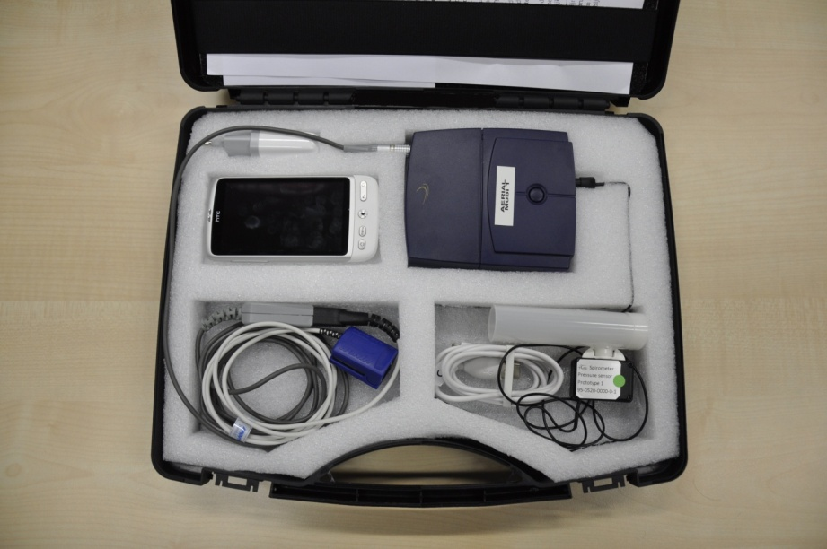
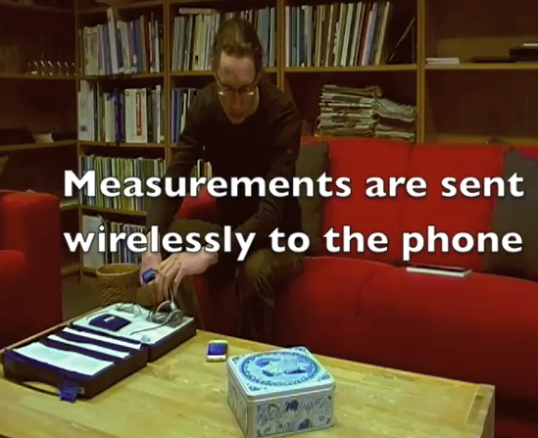
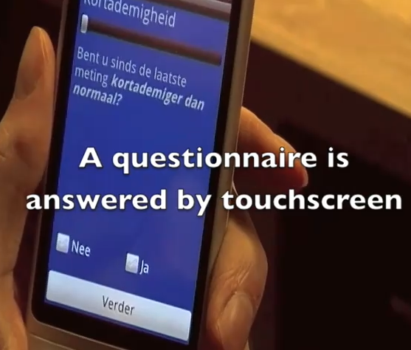
Home Healthcare project

Slide 16
"Real" Prototype Applications using iTasks
Real real-life workflow:
Crisis Management: Capturing the Netherlands Coast Guard’s Search And Rescue Workflow (ISCRAM 2011, Bas Lijnse, Jan Martin Jansen, Ruud Nanne, Rinus Plasmeijer)

Slide 17
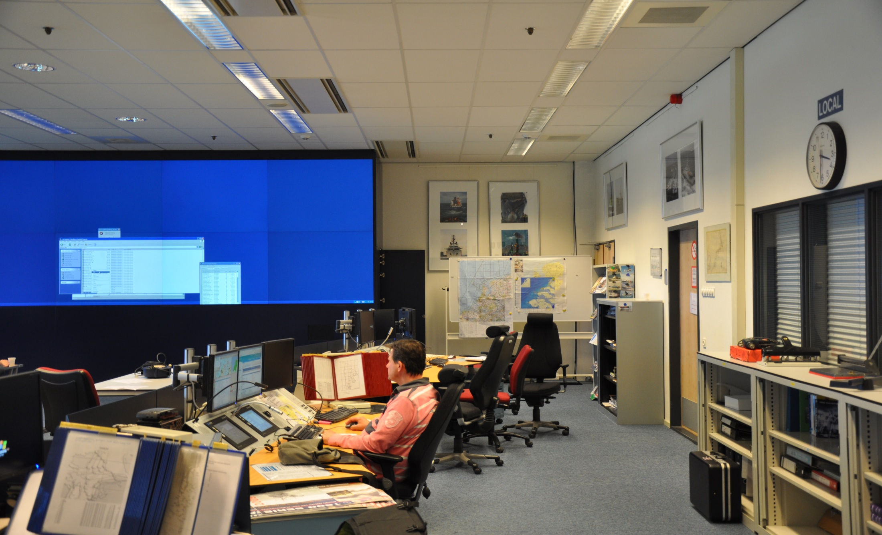
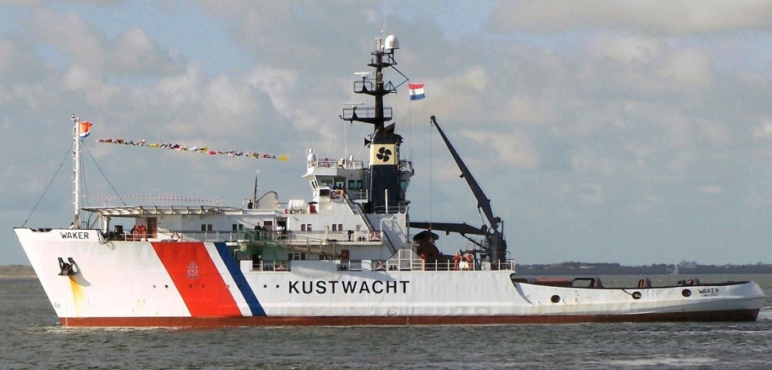
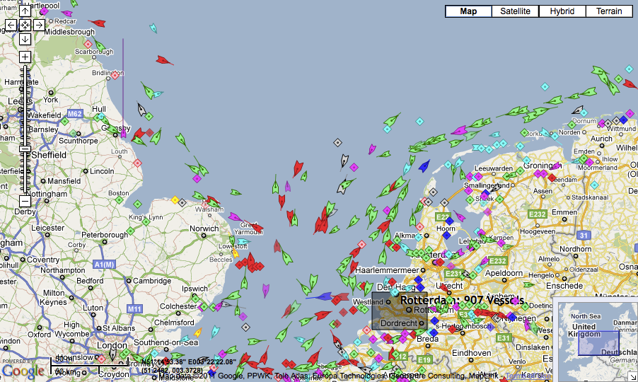


Prototype : Coast Guard Search And Rescue

Slide 18
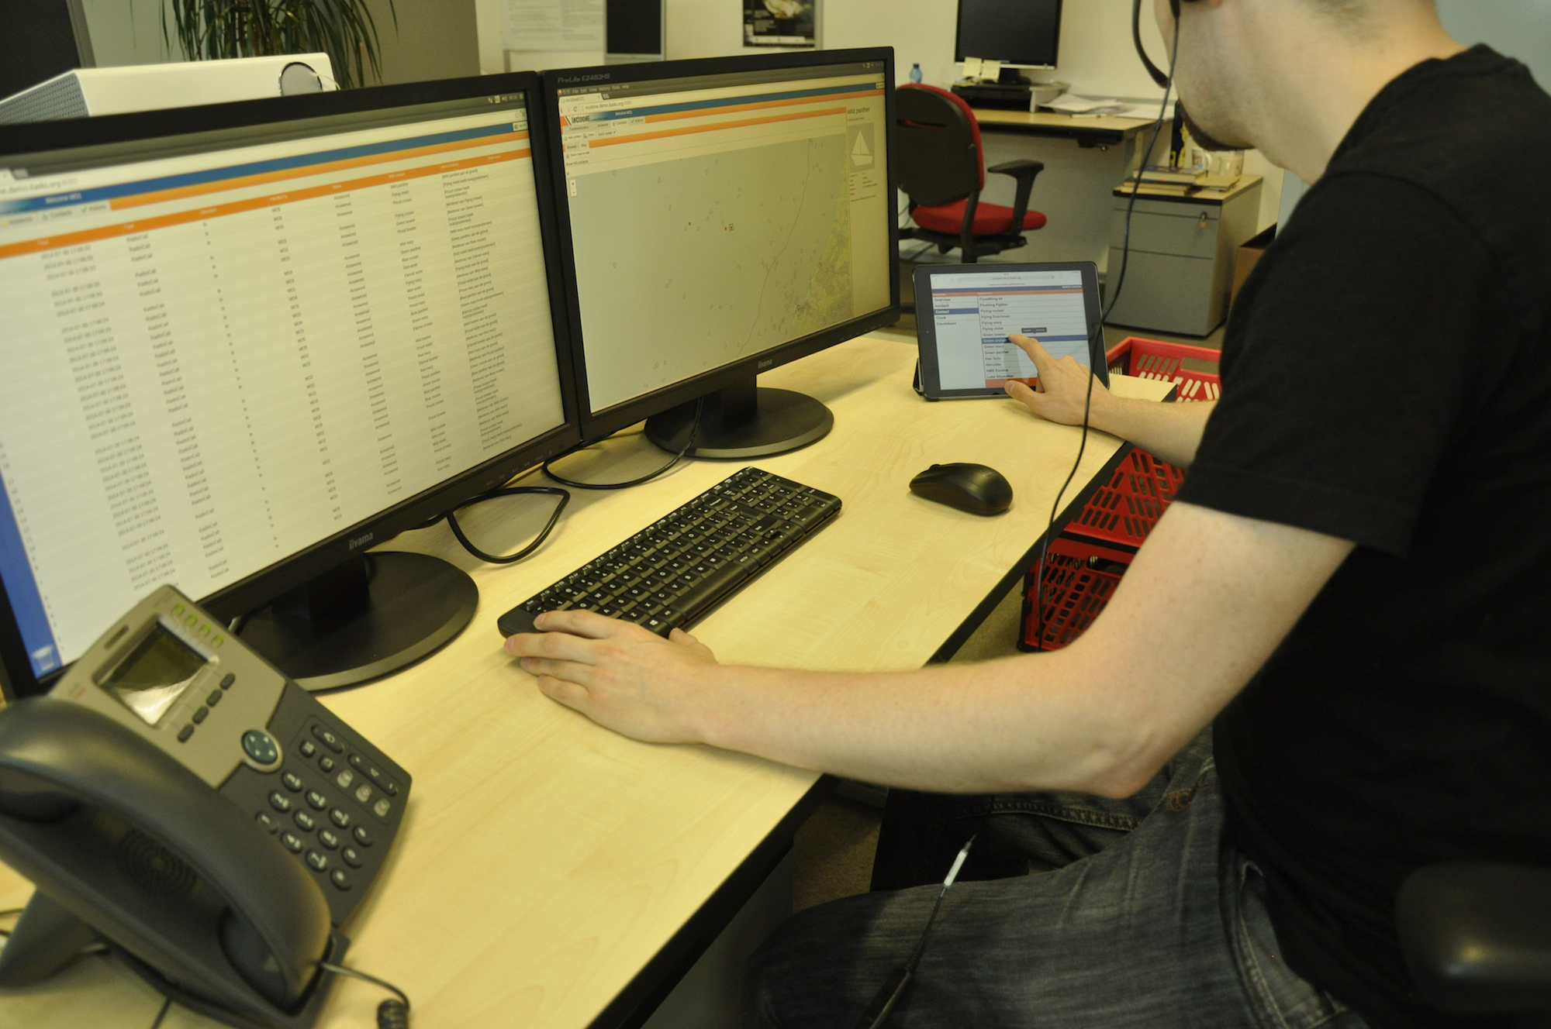
Prototype : Incidone (Bas Lijnse)

Slide 19
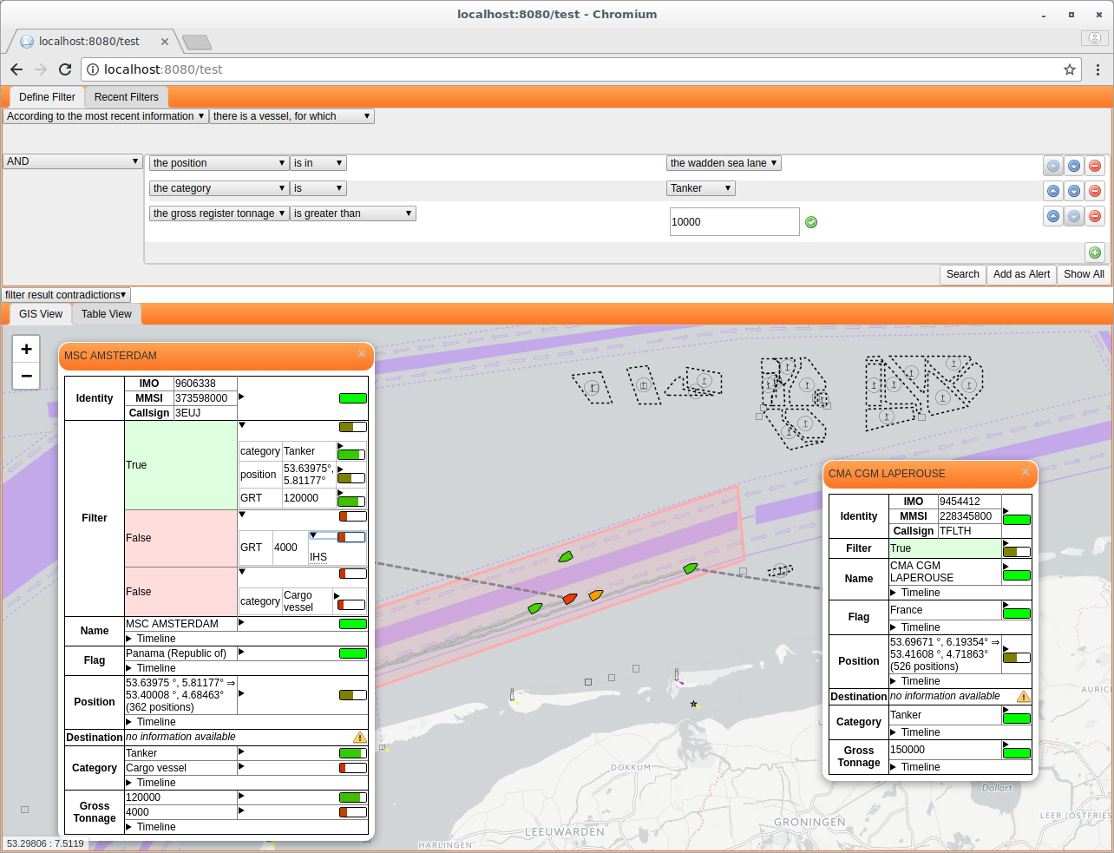
Coast Guarding (Steffen Michels)

Slide 20
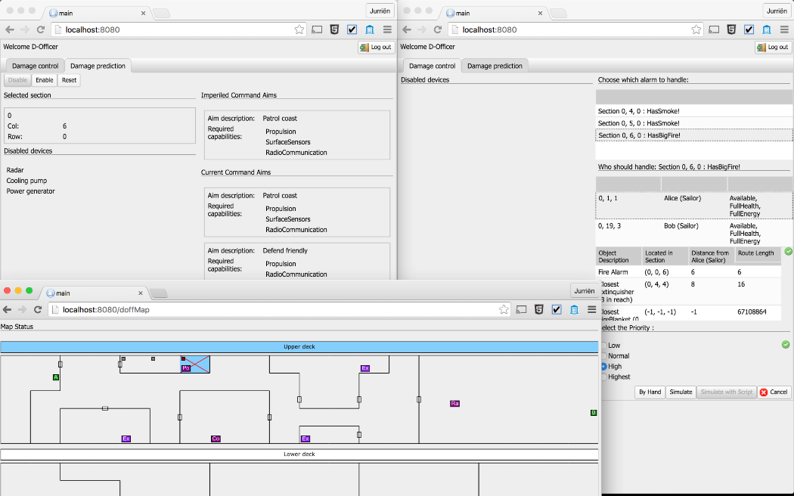
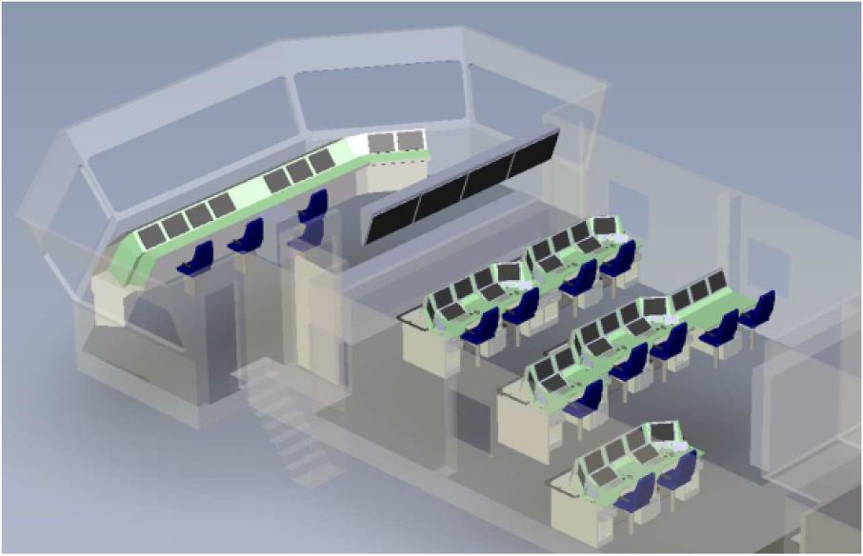
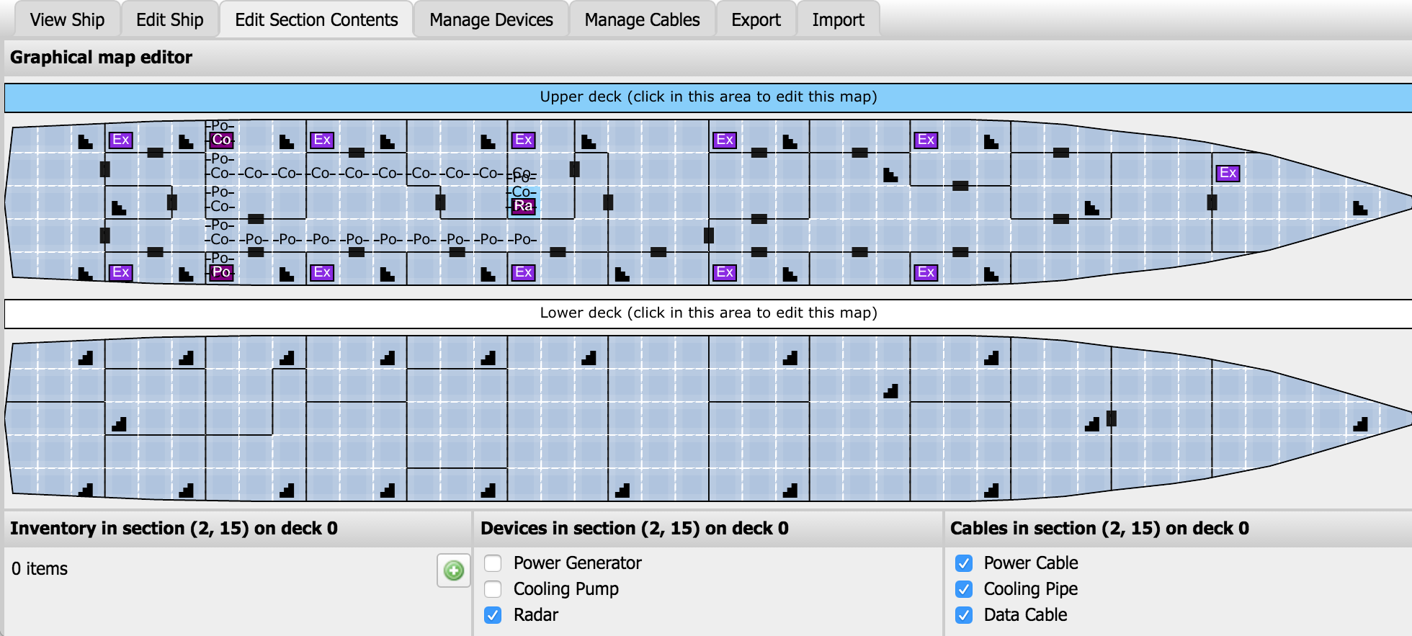
Prototype : Fregat Optimization – Navy -TNO

Slide 21
Task Oriented Programming
(Possible) Application Domains
Command and Control systems (NLDA, Navy, TNO, Coast Guard)
Health care (COPD measurements Smart Phones)
Internet of Things (Koopman, New Device Lab, RUN)
Any domain where people and systems closely work together on the net…
(Possible) Type of Applications :
for developing Web-based Multi-User Applications
for Rapid Prototyping (NLDA, TNO, Coast Guard, RUN)
to Formalize how work should /could be organized (NLDA, Coast Guard)
for Simulation (agents / decision support systems): what is the best way of working (Groenouwe, Meyer, ATIA)
for Training: mix of real people and agents (Coastguard, RUN)
to Show properties by testing, analysis or by formal proof (Klinik RUN)
as common language for communication between domain experts, programmers, end-users (Naus, Jeuring, Groenhouwe, Meyer, Stutterheim)
Compile-time: how to organize work to obtain the desired result ?
Run-time: what is actually happening, and what is the best way to proceed ?
21
Notes:
21

Slide 22
TOP
Task Oriented Programming

Slide 23
Domain Specific Questions
How to interact with end users ?
Which tasks need to be done ?
Which information need to be shared ?
What are the domain specific notions and calculation ?

Slide 24
Separations of Concerns in TOP
GUI
Specialization
(UI)
Task Definitions
(WF)
Shared
Data
Sources
(SDS)
Data Types
Traditional Functional
Programming

Slide 25

What does TOP adds on top of FP ?
FP TOP
Function Task
One Result One Result which varies over time
Reactive, value depend on value others
Special function, returning :: Task a
Function Application Task Combinators
Task values observable by others
Higher Order Functions Higher Order Tasks
Library dependent Editor
Widget based Types are Model, GUIs generated View
User-definable Specialization
GUI Combinators
Standard not supported Shares : uniform resource interface
Publish-Subscribe System
in a pure FPL Automatic Synchronize others on change
SDS Combinators
TASKS
GUIS
SDS

Slide 26
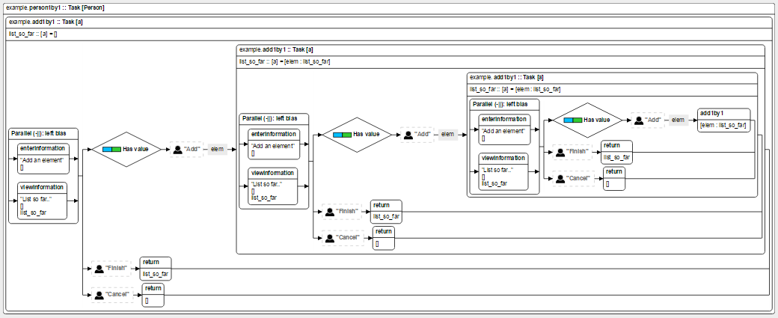
TOP – Tasks
TASKS
A task is a unit of work which delivers results of a certain type.
They can be defined by “common” Clean functions delivering a result of type :: Task a
myTask :: t₁ t₂ …. t_{n} → Task t_{r}
myTask arg₁ arg₂ … arg_{n} = some-combination-of-sub-tasks
Tonic: generated graphical representation
myTask :: Task t_{r}
arg₁ :: t₁
arg₂ :: t₂
…
arg_{n} :: t_{n}
26
Notes:
26

Slide 27
Core - Task Values
A task of type :: Task a produces :: TaskValue a as result:
:: TaskValue a = NoValue
| Value a Stability
:: Stability :== Bool
While the task is going on, its value may change over time
27
Notes:
27

Slide 28
Core - Task Values
A task of type :: Task a produces :: TaskValue a as result:
:: TaskValue a = NoValue
| Value a Stability
:: Stability :== Bool
While the task is going on, its value may change over time
NoValue
28
Notes:
28

Slide 29
Core - Task Values
A task of type :: Task a produces :: TaskValue a as result:
:: TaskValue a = NoValue
| Value a Stability
:: Stability :== Bool
While the task is going on, its value may change over time
NoValue
Value a
False
29
Notes:
29

Slide 30
Core - Task Values
A task of type :: Task a produces :: TaskValue a as result:
:: TaskValue a = NoValue
| Value a Stability
:: Stability :== Bool
While the task is going on, its value may change over time
Value a1
False
30
Notes:
30

Slide 31
Core - Task Values
A task of type :: Task a produces :: TaskValue a as result:
:: TaskValue a = NoValue
| Value a Stability
:: Stability :== Bool
While the task is going on, its value may change over time
Value a2
False
31
Notes:
31

Slide 32
Core - Task Values
A task of type :: Task a produces :: TaskValue a as result:
:: TaskValue a = NoValue
| Value a Stability
:: Stability :== Bool
While the task is going on, its value may change over time
Value a3
False
32
Notes:
32

Slide 33
Core - Task Values
A task of type :: Task a produces :: TaskValue a as result:
:: TaskValue a = NoValue
| Value a Stability
:: Stability :== Bool
While the task is going on, its value may change over time
NoValue
Value a
False
33
Notes:
33

Slide 34
Core - Task Values
A task of type :: Task a produces :: TaskValue a as result:
:: TaskValue a = NoValue
| Value a Stability
:: Stability :== Bool
While the task is going on, its value may change over time
NoValue
34
Notes:
34

Slide 35
Core - Task Values
A task of type :: Task a produces :: TaskValue a as result:
:: TaskValue a = NoValue
| Value a Stability
:: Stability :== Bool
While the task is going on, its value may change over time
NoValue
Value a
False
35
Notes:
35

Slide 36
Core - Task Values
A task of type :: Task a produces :: TaskValue a as result:
:: TaskValue a = NoValue
| Value a Stability
:: Stability :== Bool
While the task is going on, its value may change over time
NoValue
Value a
False
Value a
True
36
Notes:
36

Slide 37
Core - Task Values
A task of type :: Task a produces :: TaskValue a as result:
:: TaskValue a = NoValue
| Value a Stability
:: Stability :== Bool
While the task is going on, its value may change over time
Value a
True
37
Notes:
37

Slide 38
Core - Task Values
A task of type :: Task a produces :: TaskValue a as result:
:: TaskValue a = NoValue
| Value a Stability
:: Stability :== Bool
While the task is going on, its value may change over time
Values can be of any type: user defined, higher order (e.g another task or a function)
The current value can be observed by other tasks
Tasks never terminate, but are garbage collected if they are not needed anymore
A task actually returns a value of type TaskResult
:: TaskResult a = ValRes TimeStamp (TaskValue a)
| ∃ e: ExcRes e & iTask e
It either returns a time stamped (version number) TaskValue, or it may raise an exception of any type (for which the class iTasks exists)
NoValue
Value a
False
Value a
True
38
Notes:
38

Slide 39
Basic Tasks and Tasks Combinators
Tasks
Basic Tasks
Non-interactive
return, throw, …
Interactive editors
interact , and derived combinators like enterInformation , showInformation , …
Combinators
Sequential
step, and derived combinators like >>* , >>= , >>|,…
Parallel
parallel, and derived combinators like -&&-, -||- , …

Slide 40
Non-Interactive Basic Tasks
Lift an ordinary expression to the task domain, delivers a Stable value :
return :: a → Task a | iTask a
Raise an exceptional result (ExcRes)
throw :: a → Task e | iTask e
Conversion of Task Values
(@?) infixl 1 :: (Task a) ((TaskValue a) → (TaskValue b)) → Task b | iTask a & iTask b
(@) infixl 1 :: (Task a) (a → b) → Task b | iTask a & iTask b
Set of generic functions
Works for any first order type

Slide 41
Interactive Basic Tasks: Editors
module example
import iTasks
Start :: *World → *World
Start world = startEngine myTask world
myTask :: Task Int
myTask = enterInformation "Enter an integer" []

Slide 42
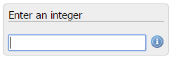
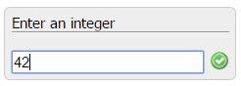
Editors
module example
import iTasks
Start :: *World → *World
Start world = startEngine myTask world
myTask :: Task Int
myTask = enterInformation "Enter an integer" []
option to map
a task value
to a view value of
another type
Prompt
Model
View
View
View
View
Editors therefore never deliver a Stable value
With the editor one can constantly change the current value

Slide 43



Editors – Task Value on Server kept synchronized with the View on Client
Model
ValRes 3 (Value 42 False) :: Task Int
View

Slide 44
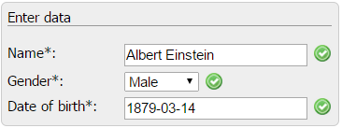
Generic Editors
:: Person = { name :: String, gender :: Gender, dateOfBirth :: Maybe Date}
:: Gender = Male | Female
derive class iTask Person, Gender
myTask :: Task Person
myTask = enterInformation "Enter data" []
Model
View
44
Notes:
44

Slide 45
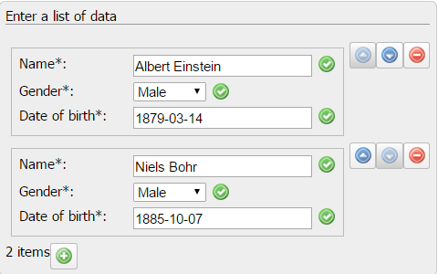
Generic Editors
myTask :: Task [Person]
myTask = enterInformation “Enter a list of data" []
Model
View
45
Notes:
45

Slide 46
Editors
NoValue
Value a
False
Value a
True
m :: Task M
Server - Web Service
view
update
value
update
Internet
Editor: interactive basic task producing unstable values
Task value and client state kept synchronized automatically
Client efficiently updated on change
Standard format exchange (JSON)
Domain Specific Platform independent GUI language
Makes Platform specific views possible (tablet, smartphone)
Works with any browser (HTML-5 compatible)
Smart tailor made editors can be defined, local state
All code defined in one Language (Clean)
 Browsers have restrictions (security, limited stack space)
 JavaScript has to be used, and it is very slow (10 times slower than Clean)
View
Client
46
Notes:
46

Slide 47
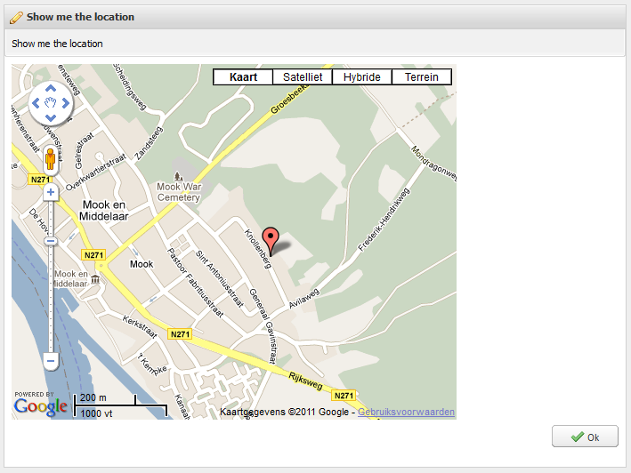
Tailor Made Smart Editors…
import GoogleMaps
pointOnMap :: Task GoogleMap
pointOnMap = enterInformation "Show me the location" []
Model
View
47
Notes:
47

Slide 48
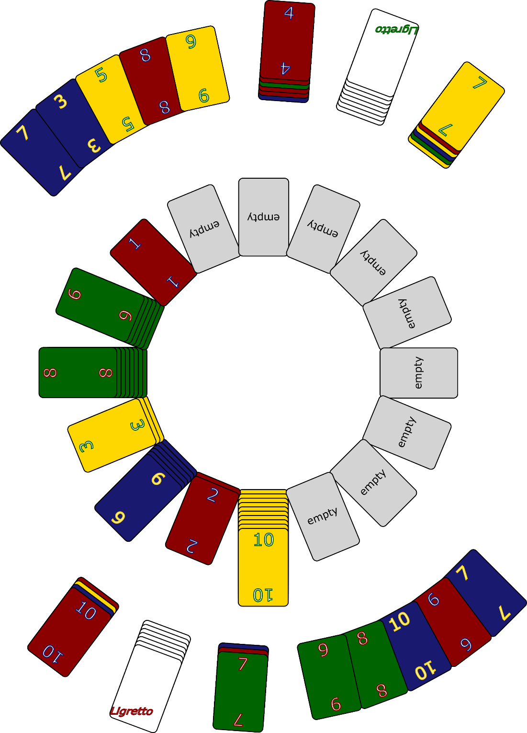
Tailor Made Smart Editors…
playLigretto :: Task Ligretto
playLigretto = enterInformation “Lets Play Ligretto" []
Model
View
48
Notes:
48

Slide 49
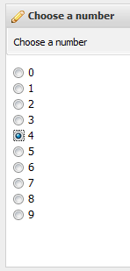
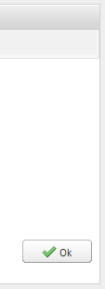
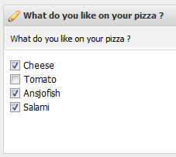
Examples of Editors…
chooseNumber :: Task Int
chooseNumber = enterChoice "Choose a number" [] [0..9]
pizzaWith :: Task [String]
pizzaWith = enterMultipleChoice "What do you like on your pizza ?" [] ["Cheese","Tomato","Ansjofish","Salami"]

Slide 50
Interactive Editors (see iTasks.WF.Tasks.Interaction)
Basic tasks: Interactive editor for filling in forms of a certain type:
viewInformation :: p [ViewOption a] a → Task a | toPrompt p & iTask a
enterInformation :: p [EnterOption a] → Task a | toPrompt p & iTask a
updateInformation :: p [UpdateOption a a] a → Task a | toPrompt p & iTask a
enterChoice :: p [ChoiceOption a] [a] → Task a | toPrompt p & iTask a
updateChoice :: p [ChoiceOption a] [a] a → Task a | toPrompt p & iTask a
enterMultipleChoice :: p [MultiChoiceOption a] [a] → Task [a] | toPrompt p & iTask a
updateMultipleChoice :: p [MultiChoiceOption a] [a] [a] → Task [a] | toPrompt p & iTask a

Slide 51
Interactive Editors (see InteractionTasks.dcl)
Basic tasks: Interactive editor for filling in forms of a certain type:
viewInformation :: p [ViewOption a] a → Task a | toPrompt p & iTask a
Describe Task
to do
Value of type a
Task returns value of type a
Non-standard view of type a
Context Restriction:
It requires instances for type “a”
for a whole bunch of predefined
type driven generic functions.
They can all be generated
automatically for any first order type.

Slide 52
Types used for interaction tasks…
viewInformation :: p [ViewOption a] a → Task a | toPrompt p & iTask a
:: ViewOption a = E.v: ViewAs (a → v) & iTask v
Any view type can be chosen
for which class iTasks exists
Define how to map value of type a
to a value of
view type v;
identity by default
all iTask class
functions for type v
will be stored
in this ADT

Slide 53
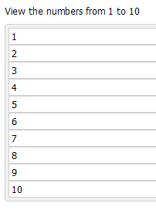
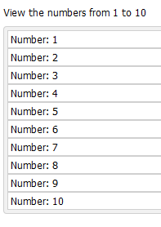
Interactive Editors (see InteractionTasks.dcl)
viewInformation :: p [ViewOption a] a → Task a | toPrompt p & iTask a
myList1 = viewInformation "View the numbers from 1 to 10" [] [1..10]
myList2 = viewInformation "View the numbers from 1 to 10"
[ViewAs (map (\n → "Number: " <+++ n))] [1..10]

Slide 54
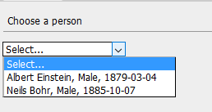
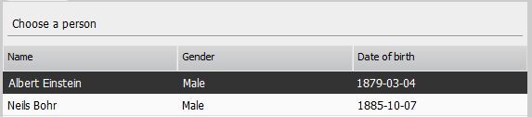
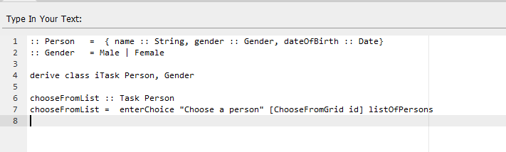
Task first, fine-tune later …
choosePerson :: [Person] → Task Person
choosePerson persons = enterChoice "Choose a person" [] persons
choosePerson2 :: [Person] → Task Person
choosePerson2 persons = enterChoice "Choose a person" [ChooseFromGrid id] persons
myEditor :: Task String
myEditor = enterInformation "Type In Your Text: " [EnterUsing id aceTextArea]
GUI’s
Editors
Model-View
Lay-out

Slide 55
Types used for interaction tasks…
enterInformation :: p [EnterOption a] → Task a | toPrompt p & iTask a
:: EnterOption a = E.v: EnterAs (v → a) & iTask v
| E.v: EnterUsing (v → a) (Editor v) & iTask v
Context Restriction
Use an existing editor
as base
With editor combinators one can easily make user definable editor
variants

Slide 56
Types used for interaction tasks…
updateInformation :: p [UpdateOption a a] a → Task a | toPrompt p & iTask a
:: UpdateOption a b = E.v: UpdateAs (a → v) (a v → b) & iTask v
Combination called a lens
Any view can be chosen
Define how to map value a to view v
Any view can be chosen
Define how to map view v to value a
Context Restriction
Context Restriction
Define how to map the view v back to a value b given the current value a

Slide 57
Types used for interaction tasks…
:: ViewOption a = E.v: ViewAs (a → v) & iTask v
| E.v: ViewUsing (a → v) (Editor v) & iTask v
:: EnterOption a = E.v: EnterAs (v → a) & iTask v
| E.v: EnterUsing (v → a) (Editor v) & iTask v
:: UpdateOption a b = E.v: UpdateAs (a → v) (a v → b) & iTask v
| E.v: UpdateUsing (a → v) (a v → b) (Editor v) & iTask v
:: ChoiceOption a = E.v: ChooseFromDropdown (a → v) & iTask v
| E.v: ChooseFromCheckGroup (a → v) & iTask v
| E.v: ChooseFromList (a → v) & iTask v
| E.v: ChooseFromGrid (a → v) & iTask v
…

Slide 58
Types used for interaction tasks…
viewInformation :: p [ViewOption a] a → Task a | toPrompt p & iTask a
class toPrompt p where toPrompt :: p → UI
instance toPrompt (), String, (String, String) , [p] | toPrompt p , …
class iTask a | gEditor{|*|} // Interactive Form generation
, gText{|*|} // Textual visualization
, JSONEncode{|*|} // Serialization
, JSONDecode{|*|} // De-serialization
, gDefault{|*|} // Default Value generator
, gEq{|*|} // Equality
, TC // Conversion to and from type Dynamic

Slide 59
Types used for interaction tasks…
generic gEditor a | gText a, gDefault a, JSONEncode a, JSONDecode a
:: Editor a
generic gText a :: TextFormat (Maybe a) → [String]
generic gDefault a :: a
generic JSONEncode a :: a → [JSONNode]
generic JSONDecode a :: [JSONNode] → (Maybe a, [JSONNode])
generic gEq a :: a a → Bool
TC is a special class automatically instantiated by the compiler for every “known” type…
toDynamic :: a → Dynamic | TC a
fromDynamic :: Dynamic → a | TC a

Slide 60
Several Interactive Editors Variants
All instantiations of one-and-the-same Core – Editor…
viewInformation :: p [ViewOption a] a → Task a | toPrompt p & iTask a
enterInformation :: p [EnterOption a] → Task a | toPrompt p & iTask a
updateInformation :: p [UpdateOption a a] a → Task a | toPrompt p & iTask a
enterChoice :: p [ChoiceOption a] [a] → Task a | toPrompt p & iTask a
updateChoice :: p [ChoiceOption a] [a] a → Task a | toPrompt p & iTask a
enterMultipleChoice :: p [MultiChoiceOption a] [a] → Task [a] | toPrompt p & iTask a
updateMultipleChoice :: p [MultiChoiceOption a] [a] [a] → Task [a] | toPrompt p & iTask a
...
60
Notes:
60

